Slide 1
Regression
(2 of 4)
Jeanette Mumford
Notes:
11 minutes

Slide 2
Place to ask questions
(anonymous, but be polite)
tinyurl.com/questions-for-jeanette

Slide 3
Goals
Practice interpreting regression parameters
That’s it!

Slide 4

The simplest model: 1- sample t-test
You’ve estimated a brain activation difference between two tasks (contrast) for each subject. You want to know if the mean difference is different from 0.

Slide 5
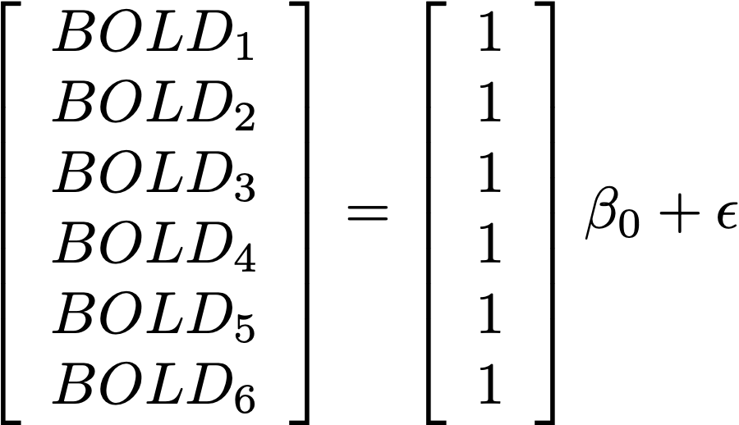
Matrix form

Slide 6
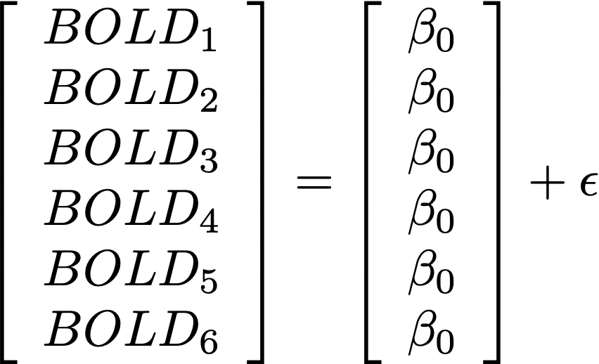
Matrix form

Slide 7
Two sample t-test
Numerous formulations (I’ll show 2!)
G1 is an indicator for Group 1
= 1 for Group 1
= 0, otherwise (Group 2)

Slide 8
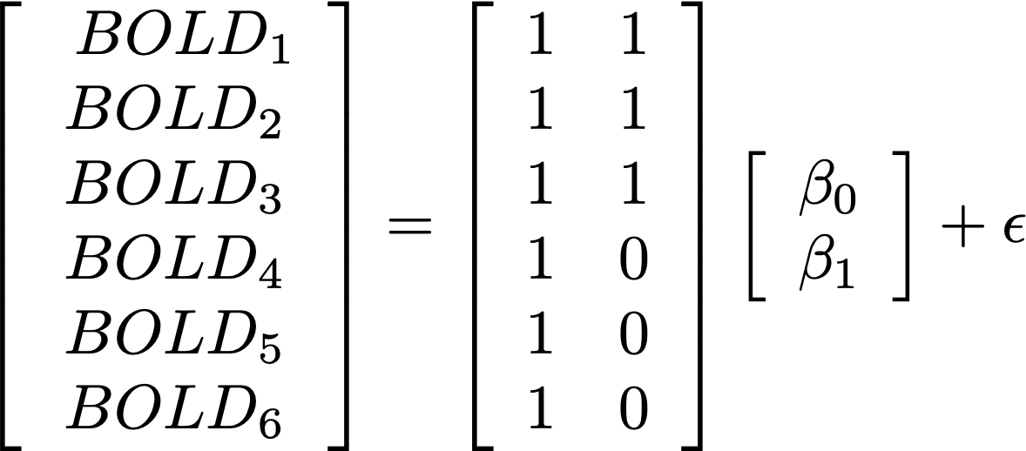
Be careful!

Slide 9
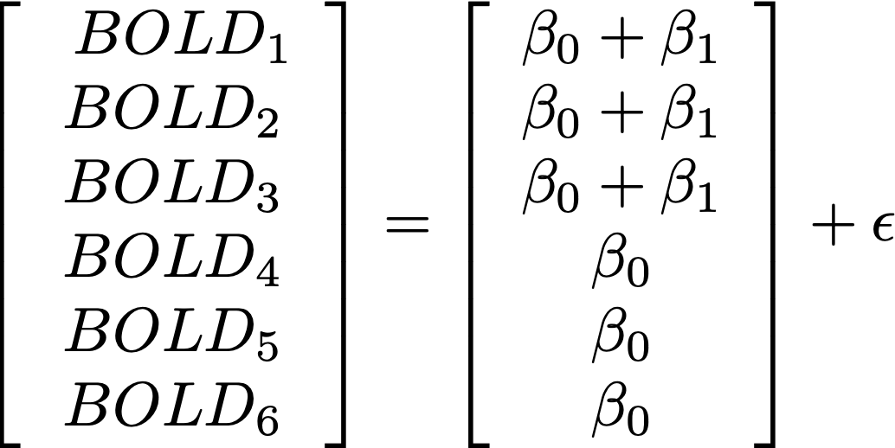
Be careful!
What is B1?
What is B0?

Slide 10
Be careful!
What is B1?
G1 - G2
What is B0?
Mean of G2

Slide 11
Two sample t-test: Formulation #2

Slide 12
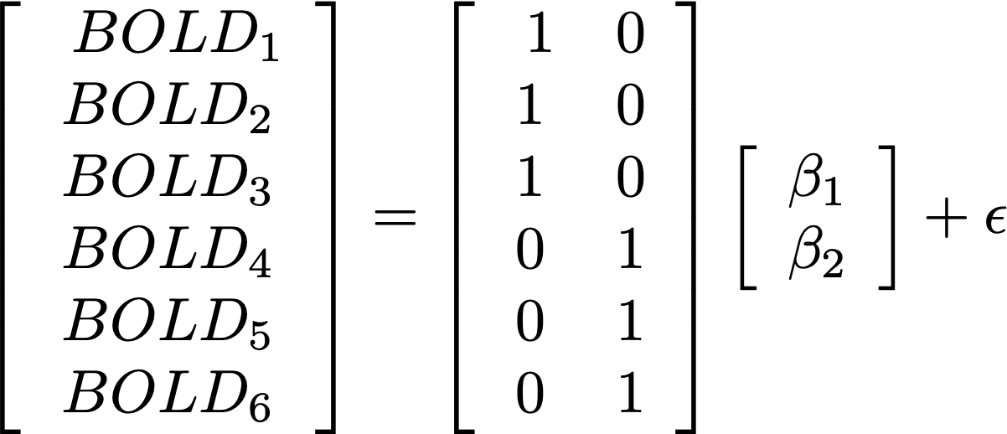

Slide 13
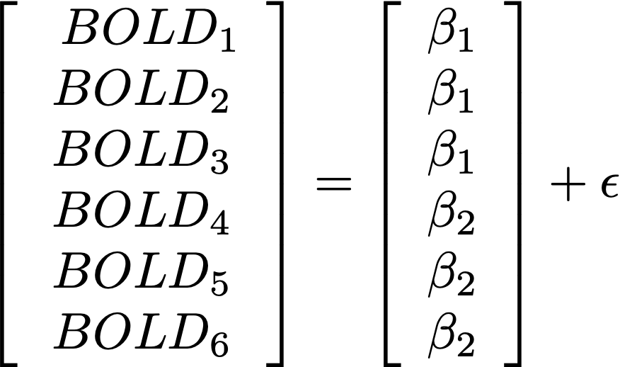
What are the interpretations of the betas??

Slide 14
How do we test a group difference?
Contrasts

Slide 15
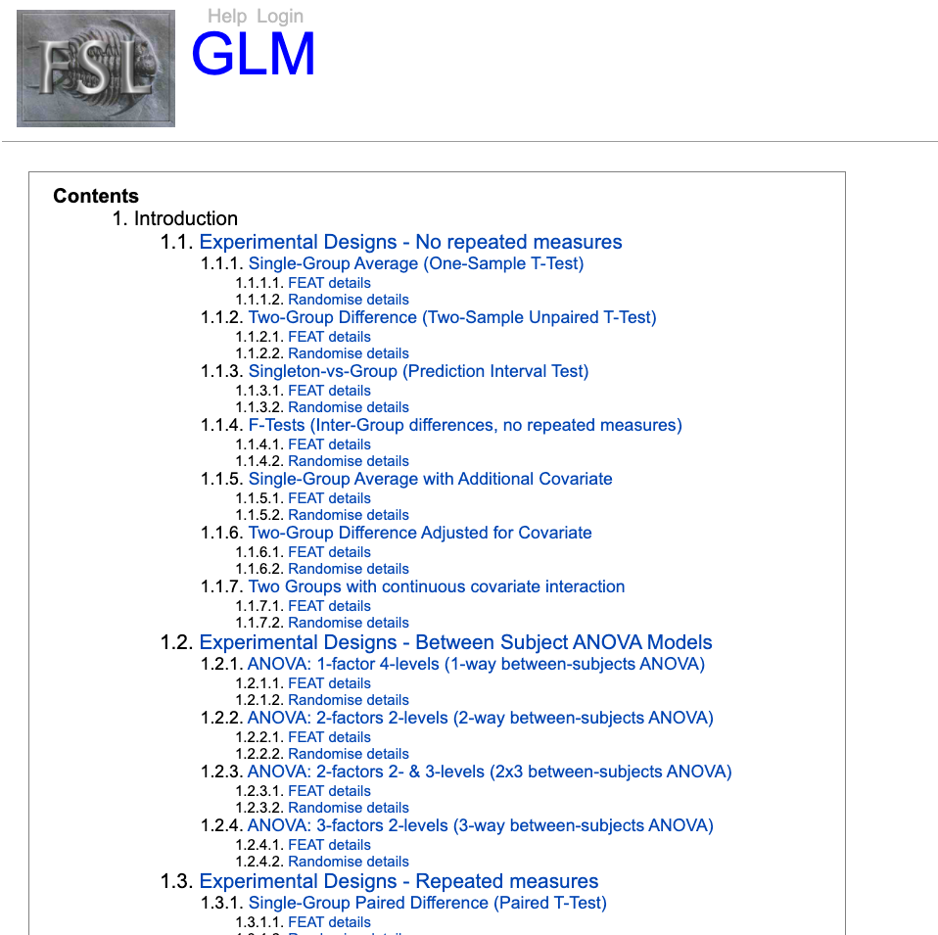
So many more model setups
https://fsl.fmrib.ox.ac.uk/fsl/fslwiki/GLM

Slide 16
That’s it!
The quiz will definitely have questions about design matrix setup, so bookmark that page!

